Slide 1
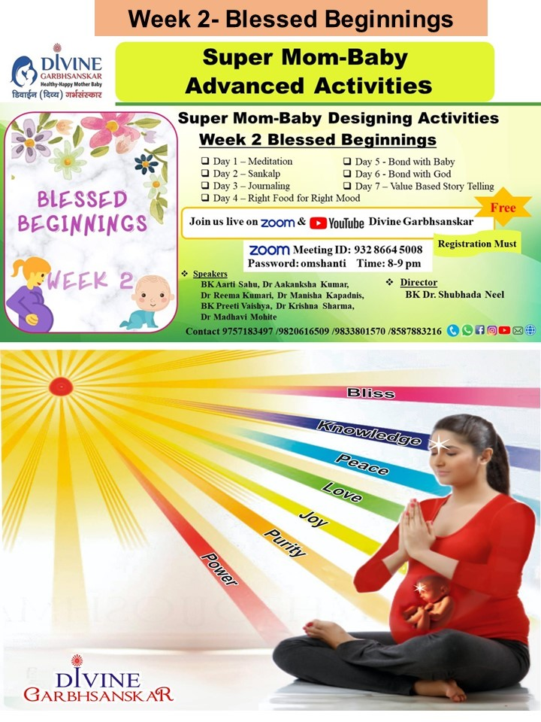

Slide 5
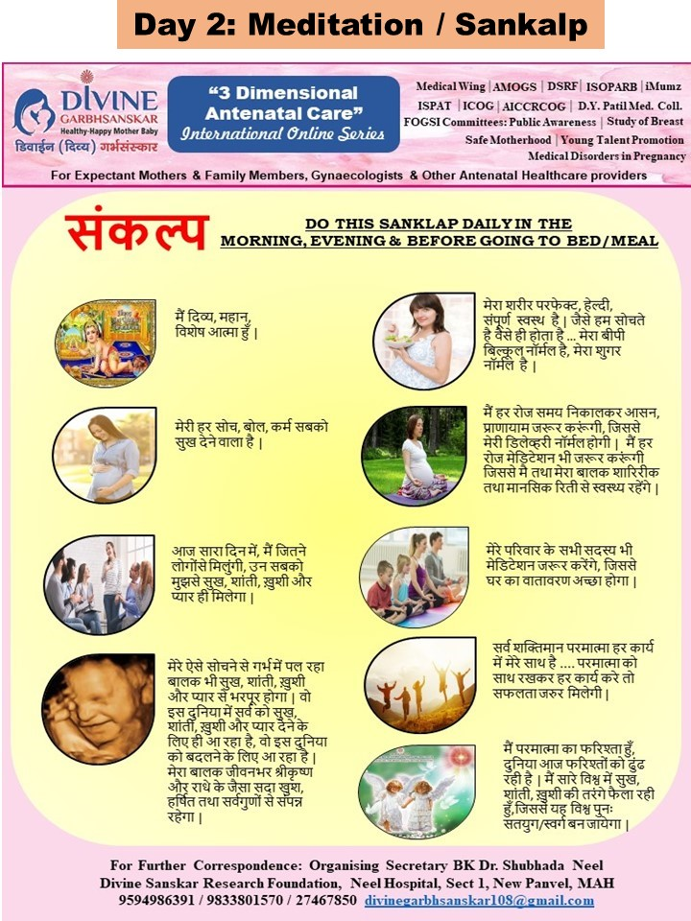

Slide 10
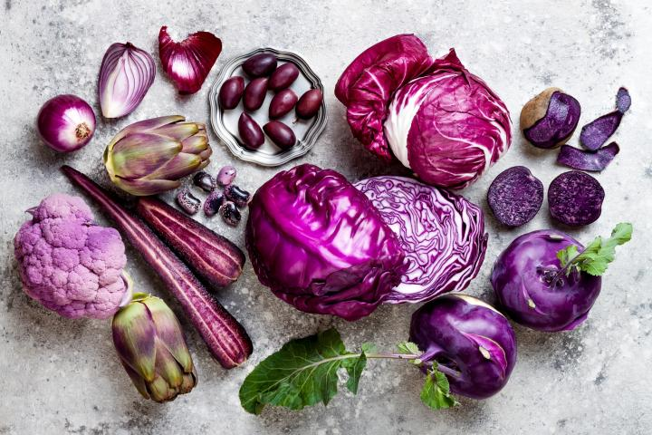
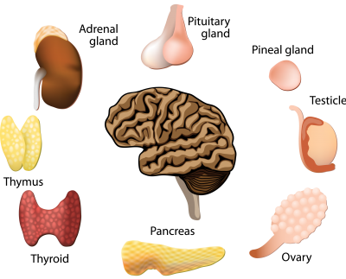
BLISS
ENDOCRINE
e

Slide 11
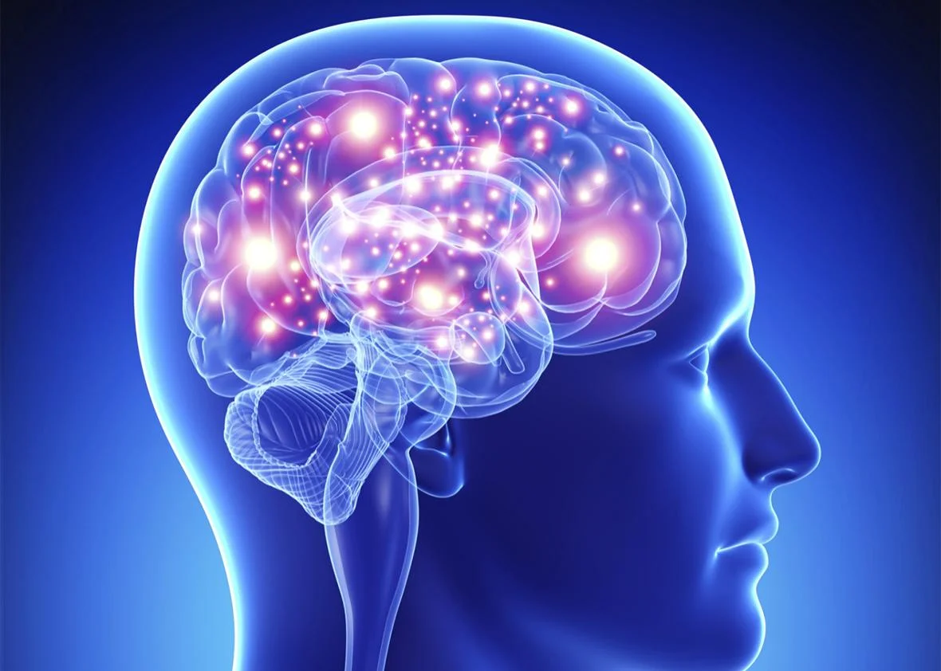
KNOWLEDGE
BRAIN
e

Slide 12
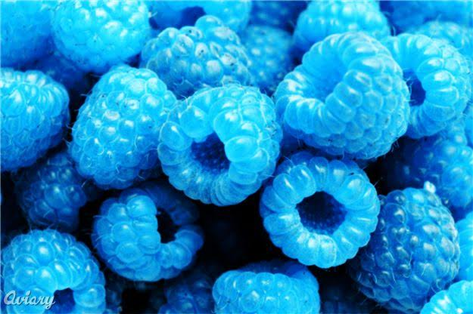
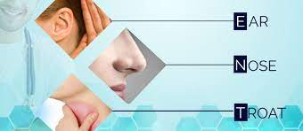
PEACE
E N T
e

Slide 13
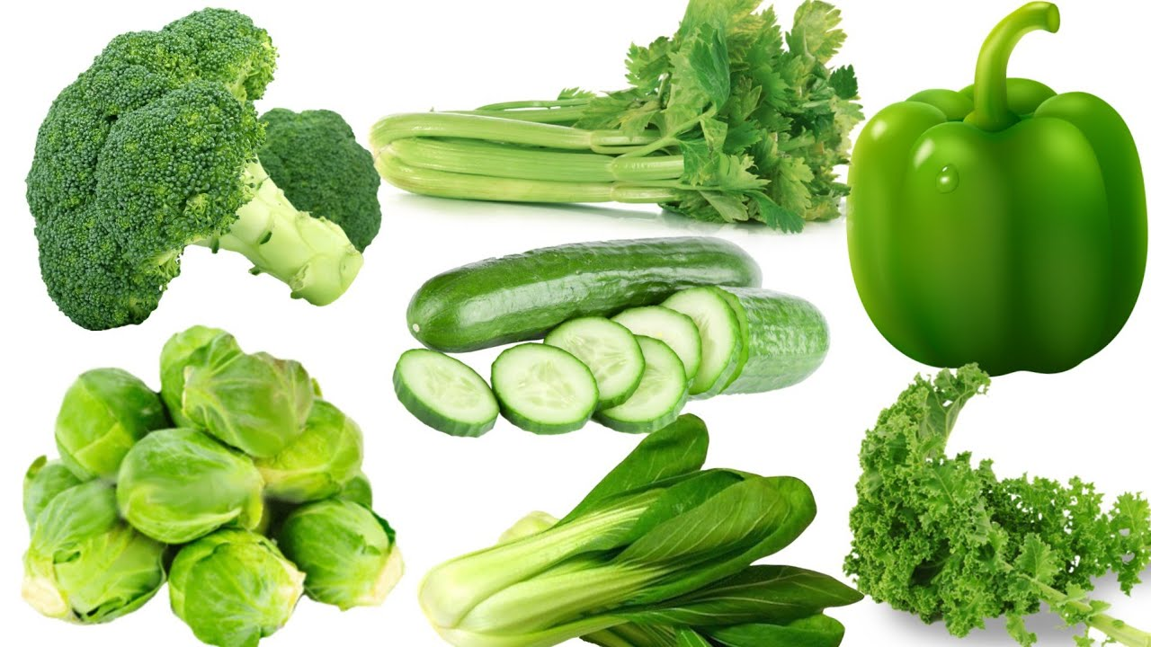
LOVE
HEART
e

Slide 14
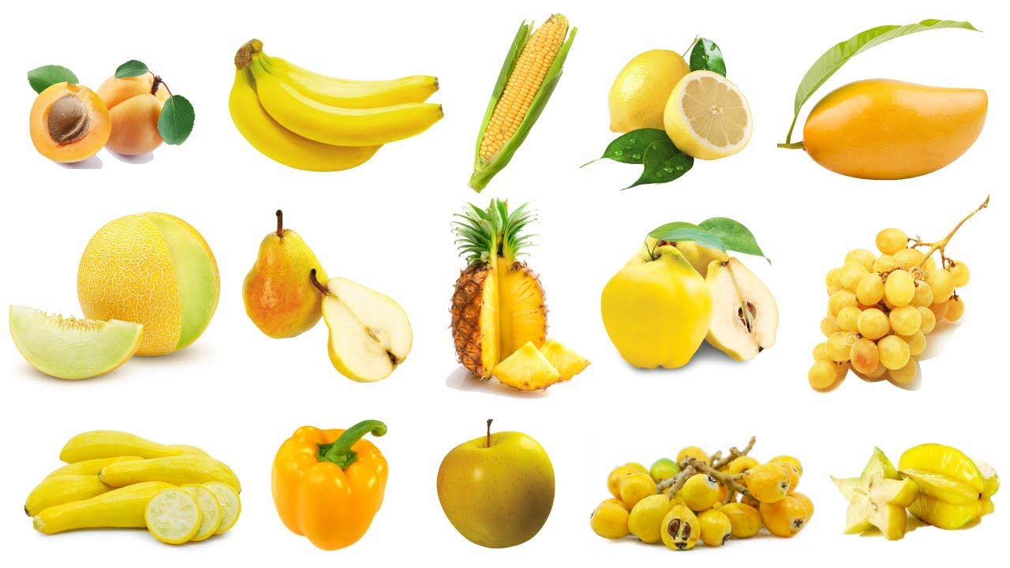
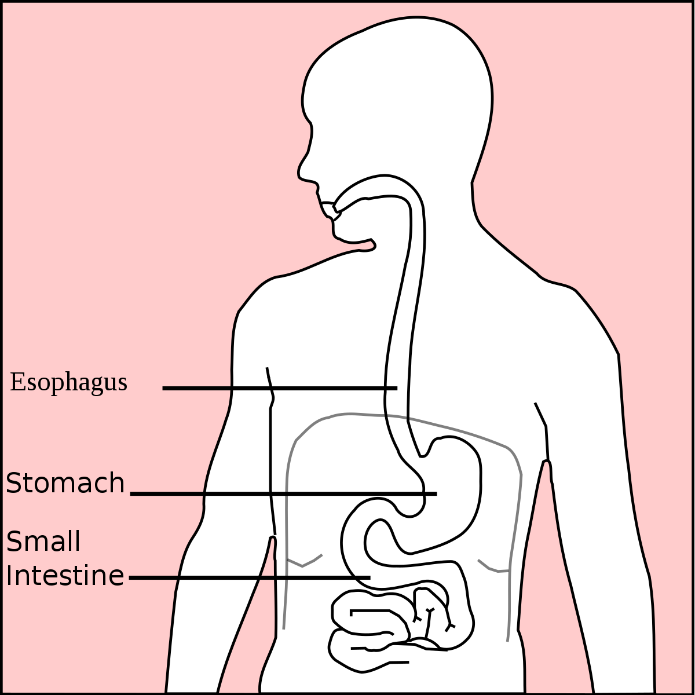
HAPPINESS
STOMACH
e

Slide 15
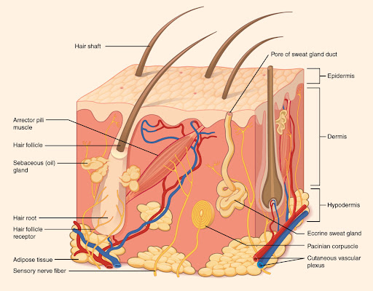
PURITY
BLOOD & SKIN
e

Slide 16
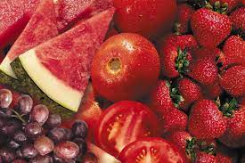
POWER
MUSCLES & BONES

Slide 17
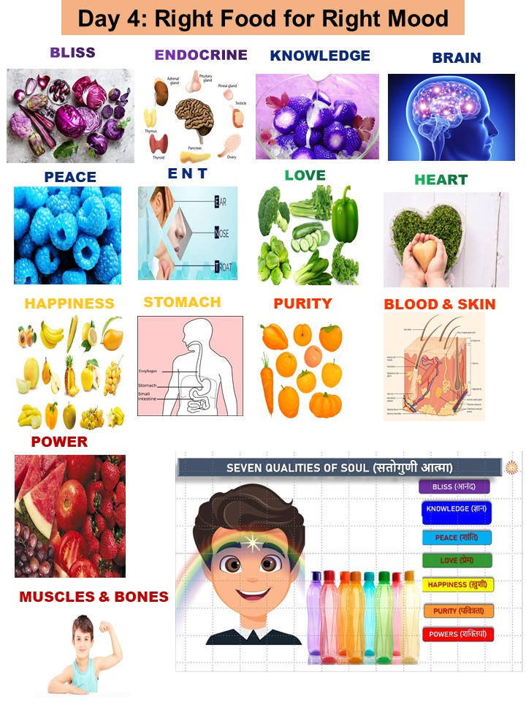

Slide 18
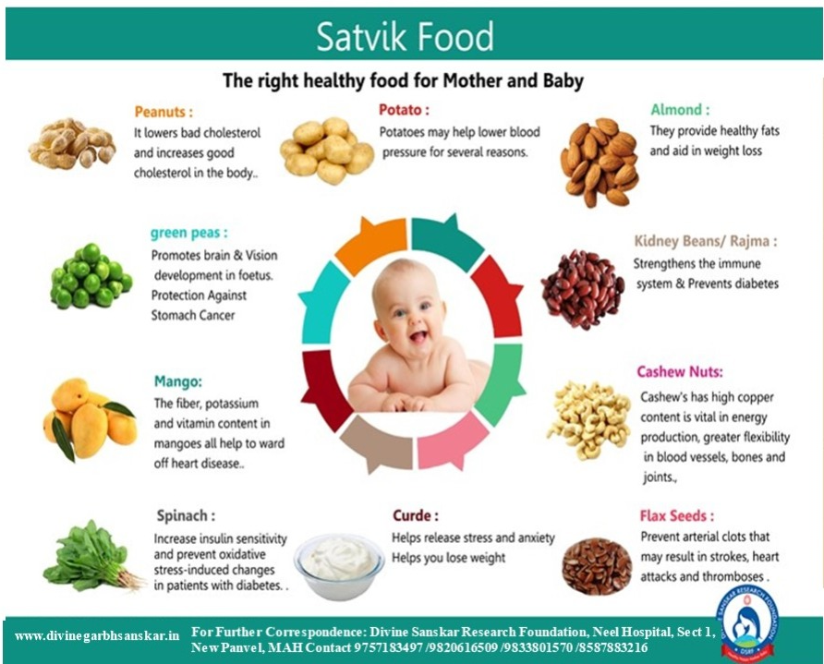

Slide 19
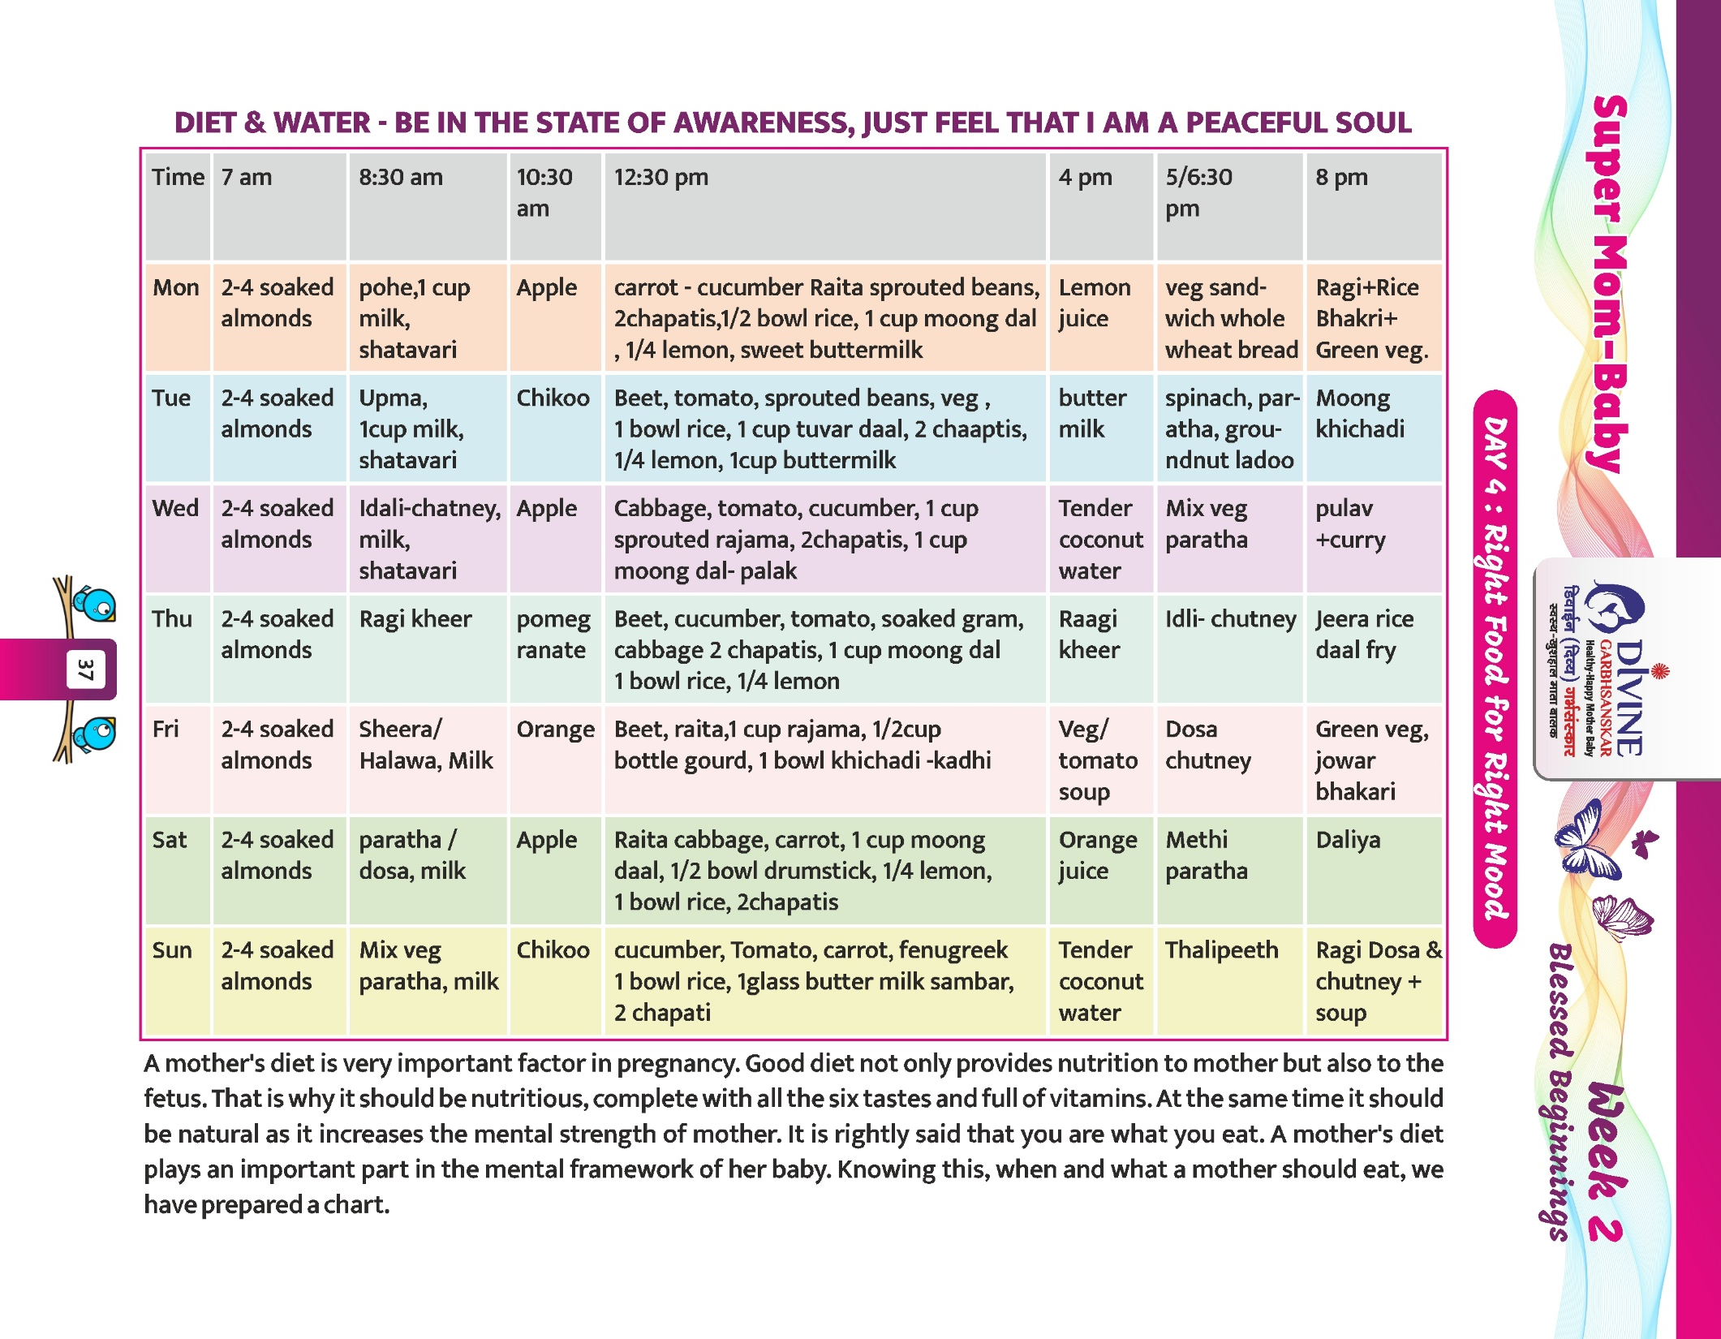

Slide 27
Highlights of the Journal
Hard bound cover
130 pages of Rich Quality
Daily Reflective Activities
28 Meditation Commentaries
Diet Chart
Exercises/Pranayama for Normal Delivery
Weekly Baby Talk Transcript
Hospital/Labour Room Checklist
Comprehensive Guide for Rajyoga Meditation
Practical Tips of Sleep Hygiene
Auto suggestions for sound sleep
Maths Masti - Creative Puzzles with Solutions
Bi lingual (English & Hindi)
7304255292
9833801570

Slide 28
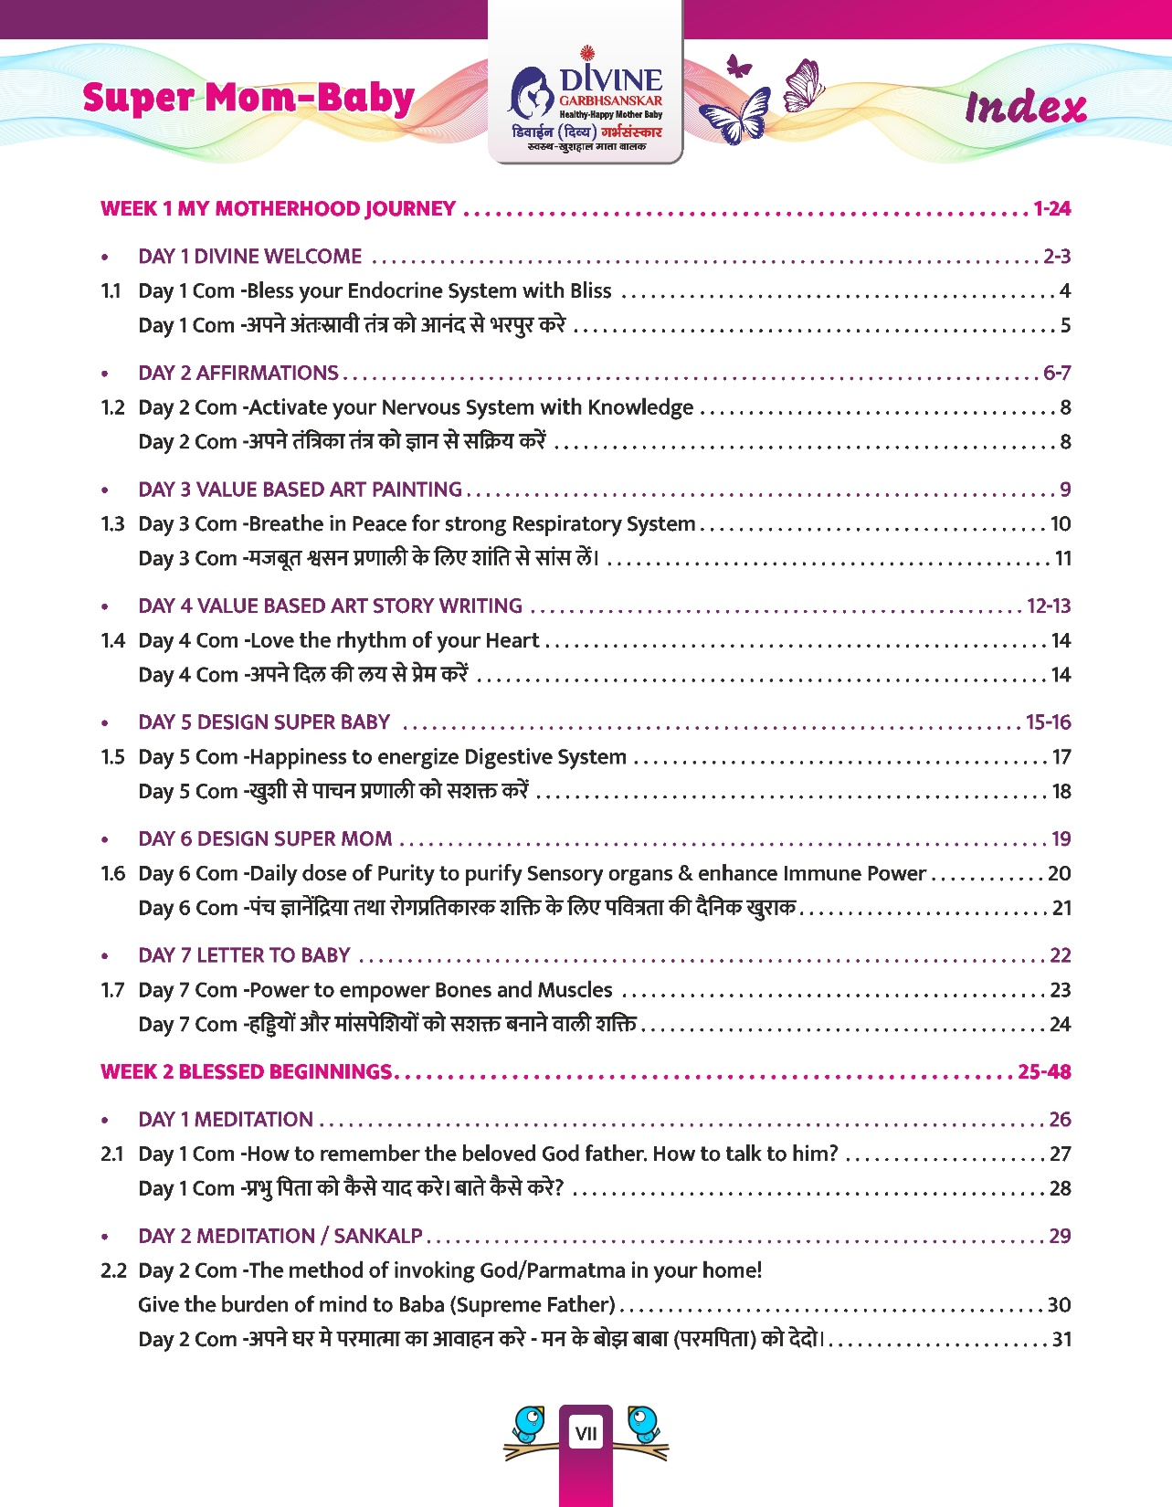

Slide 29
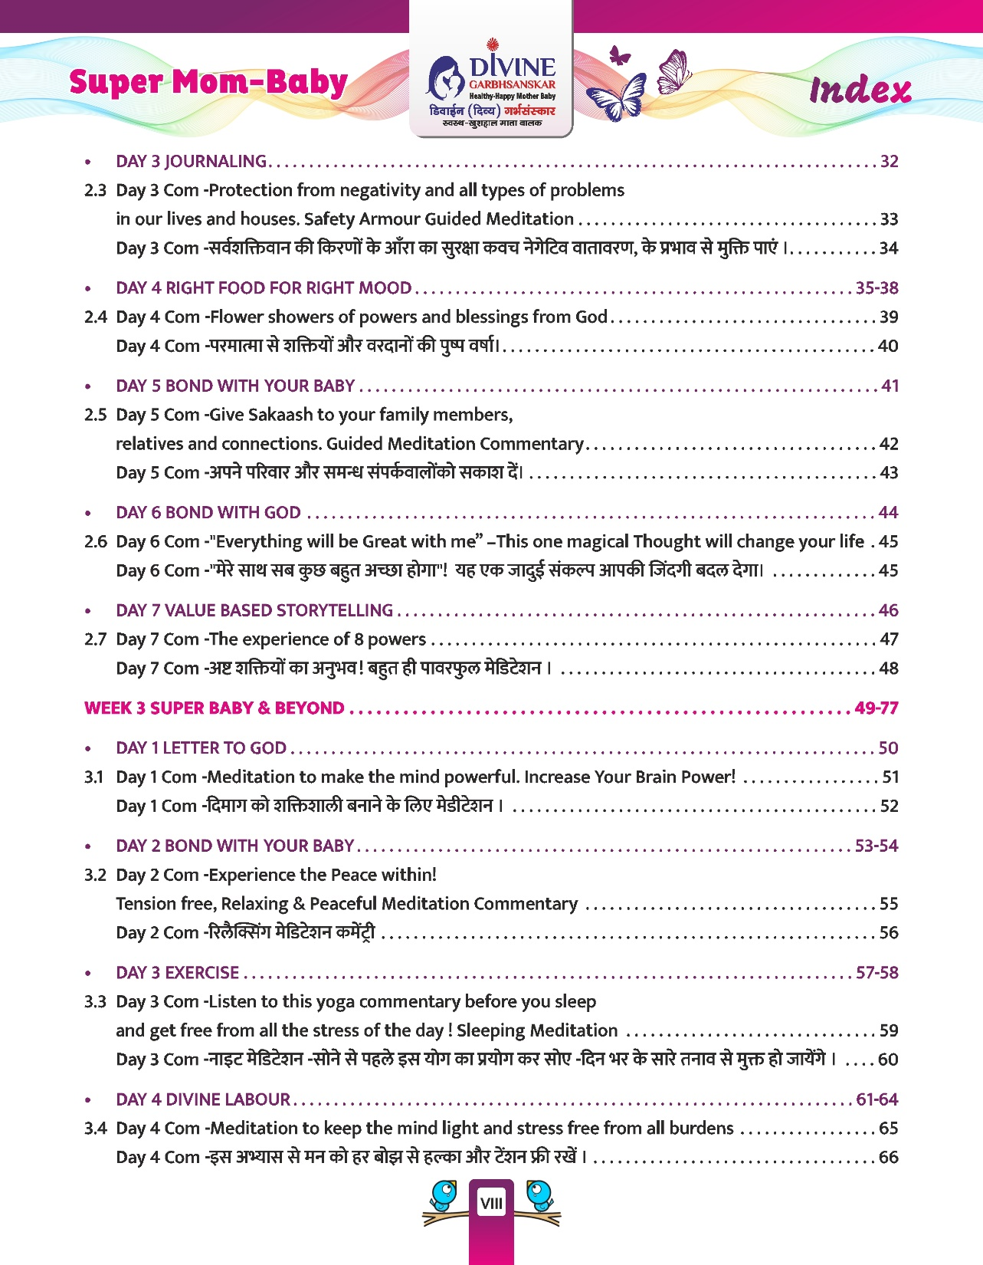

Slide 30
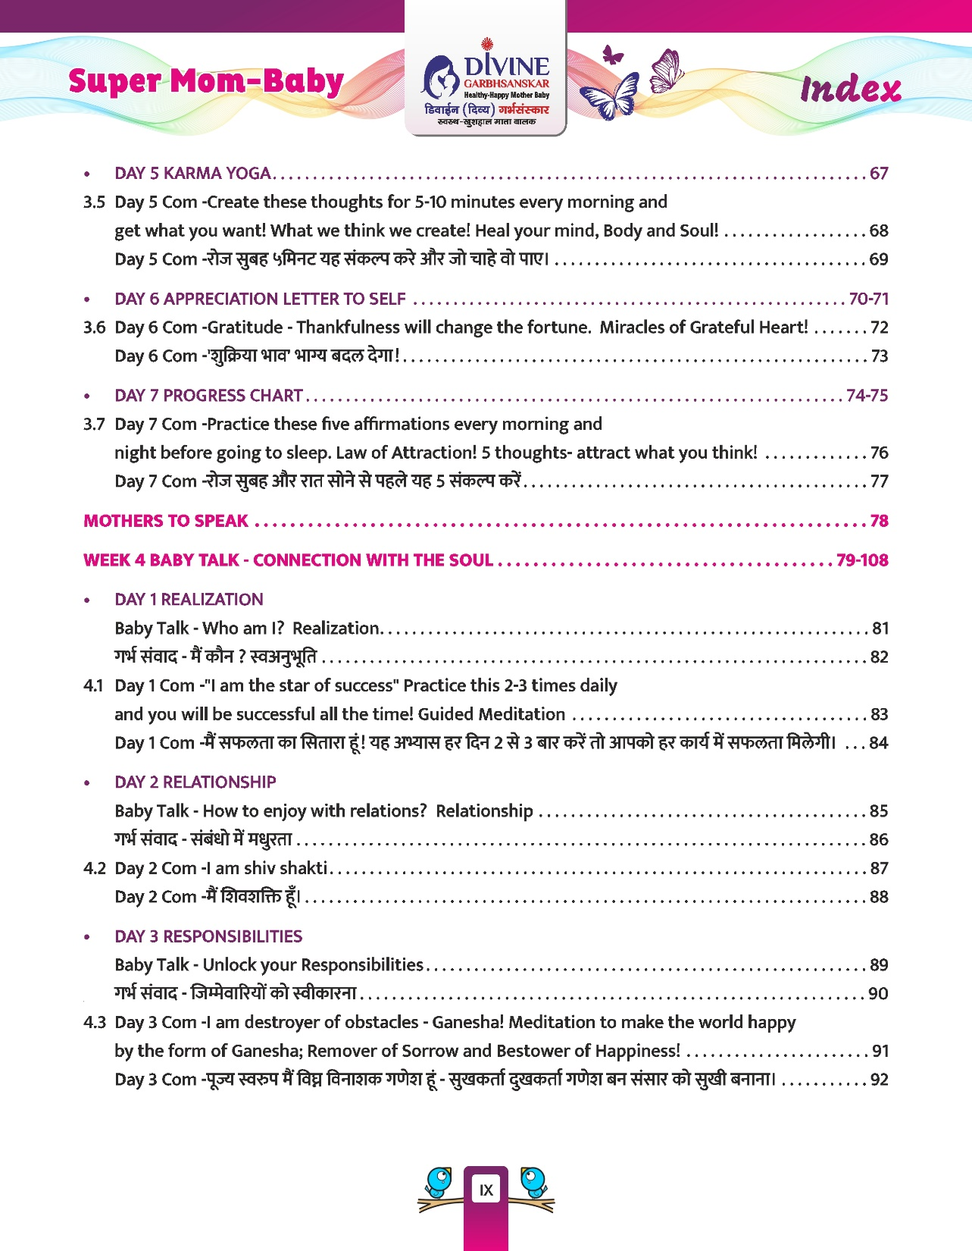

Slide 31
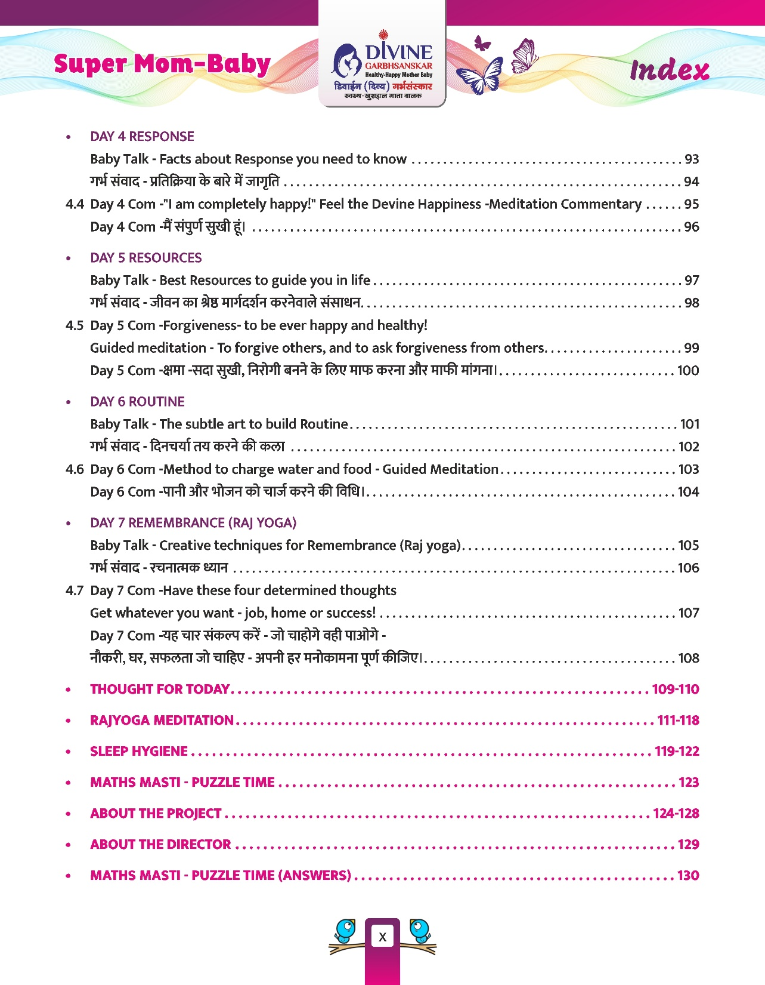

Slide 33
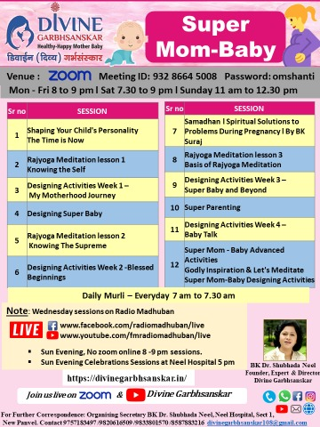

Slide 36
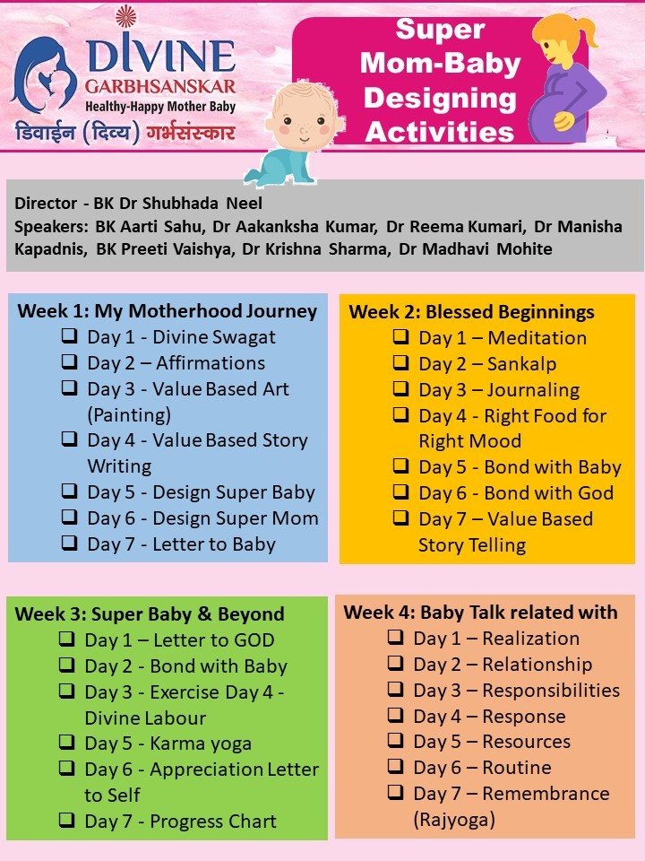

Slide 37
