Slide 8
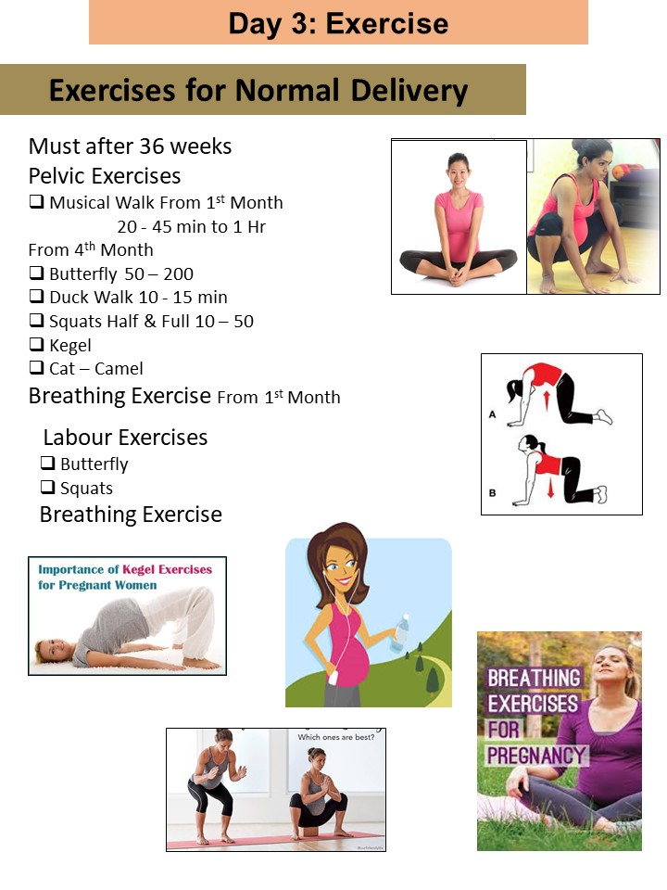

Slide 9
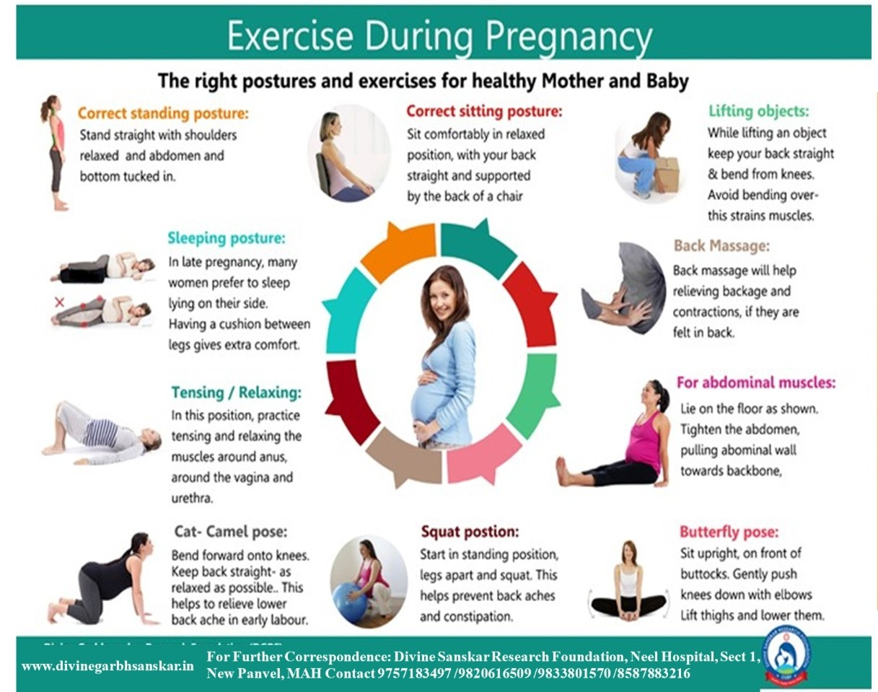

Slide 13
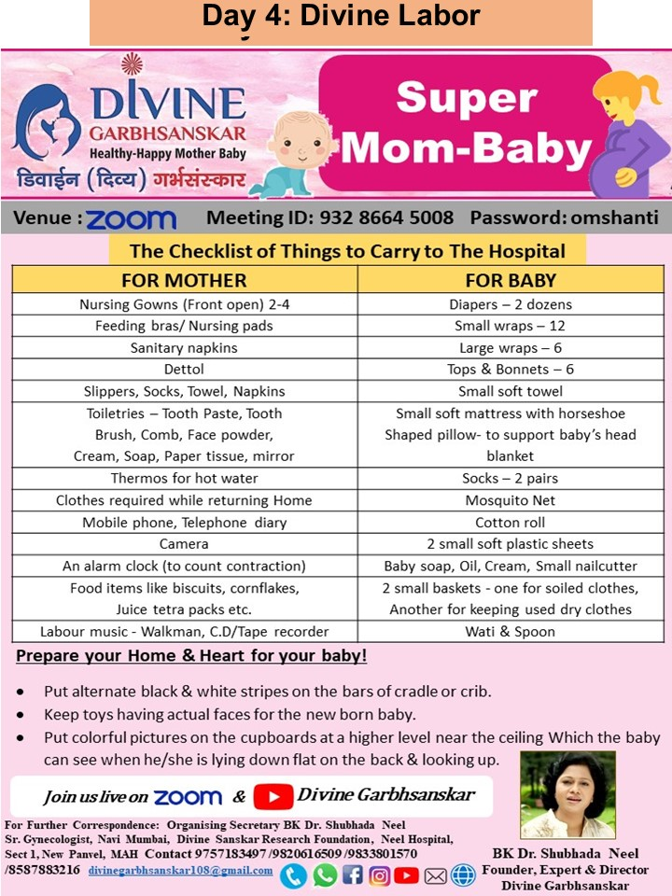

Slide 15
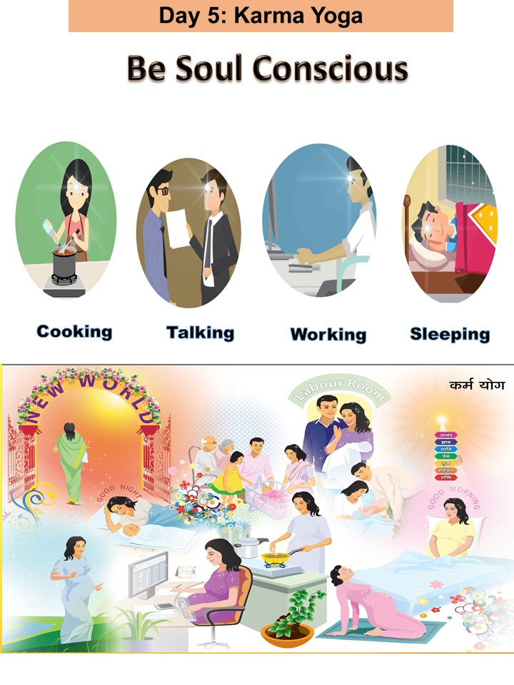

Slide 17
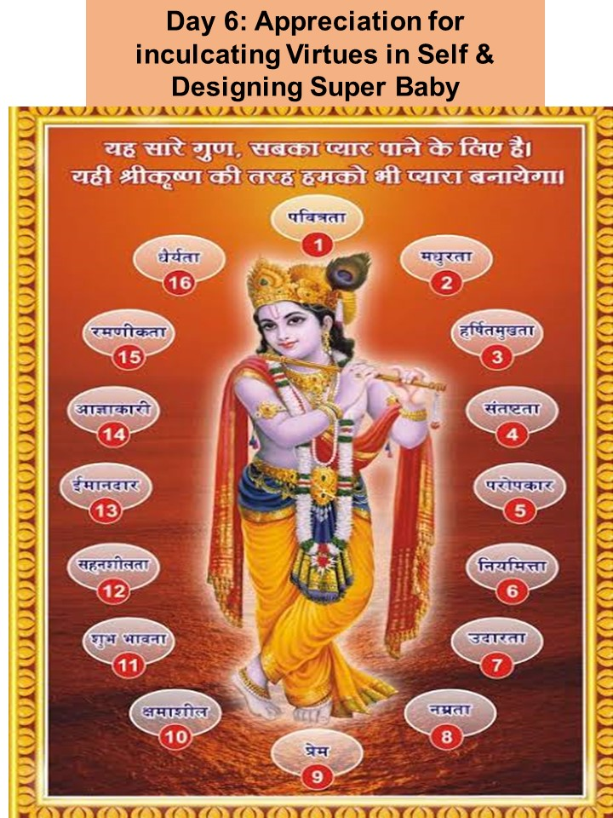

Slide 18
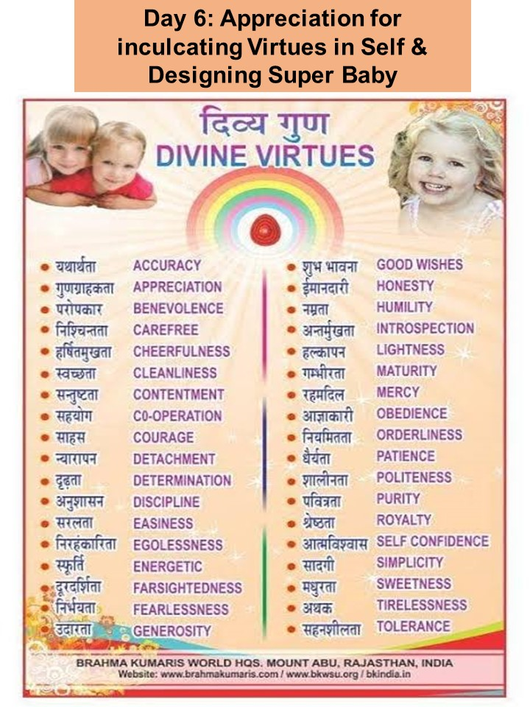

Slide 19
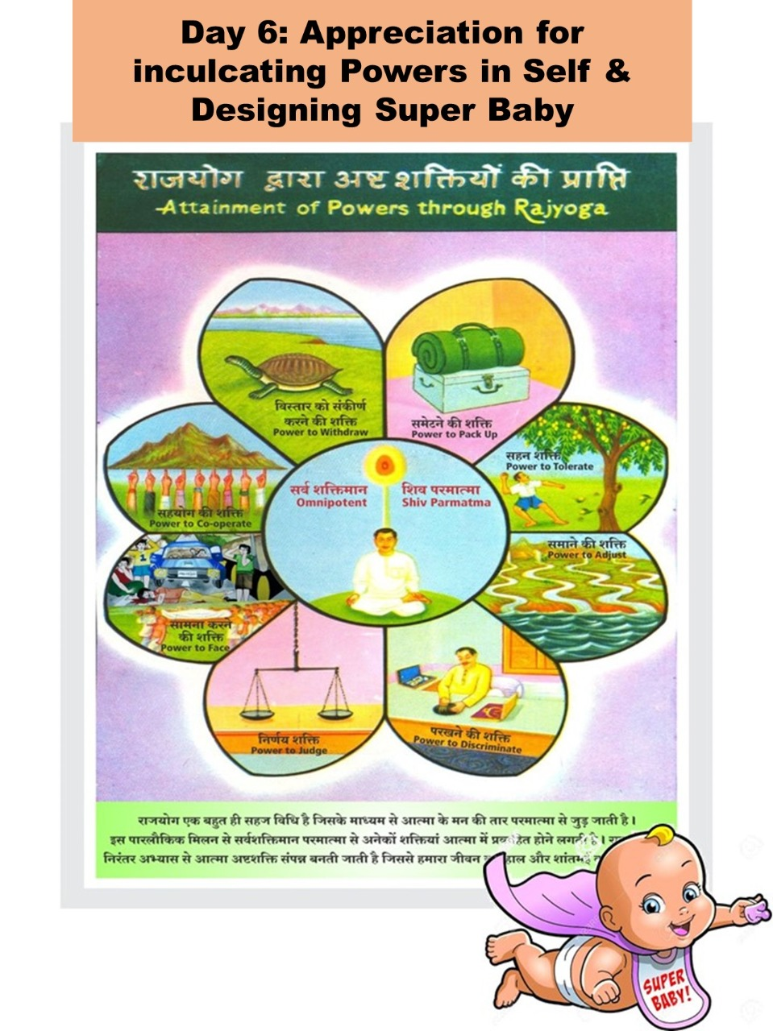

Slide 22
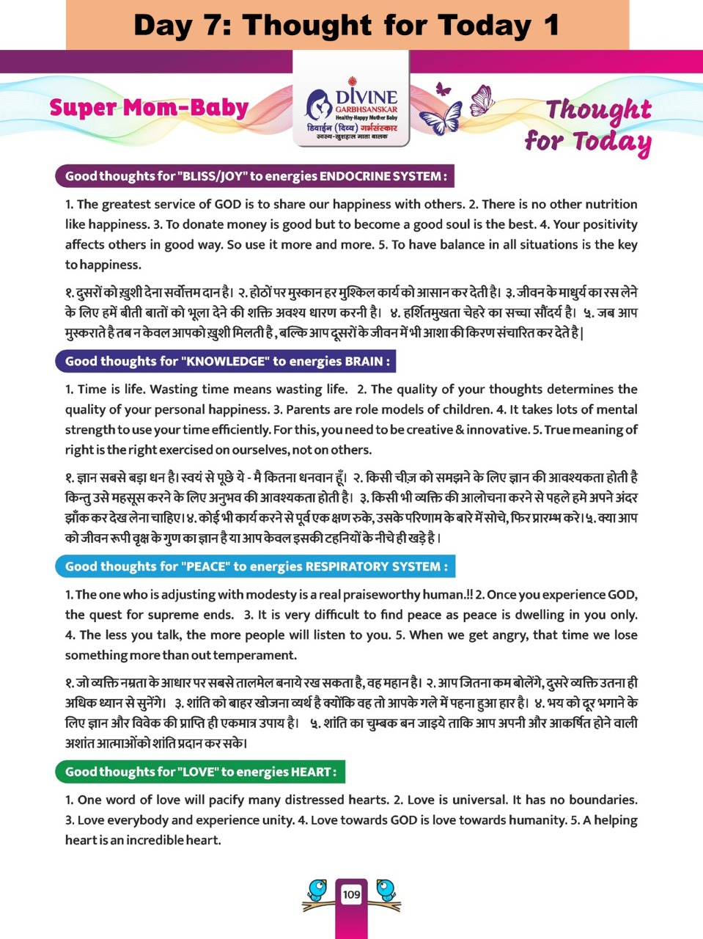

Slide 24
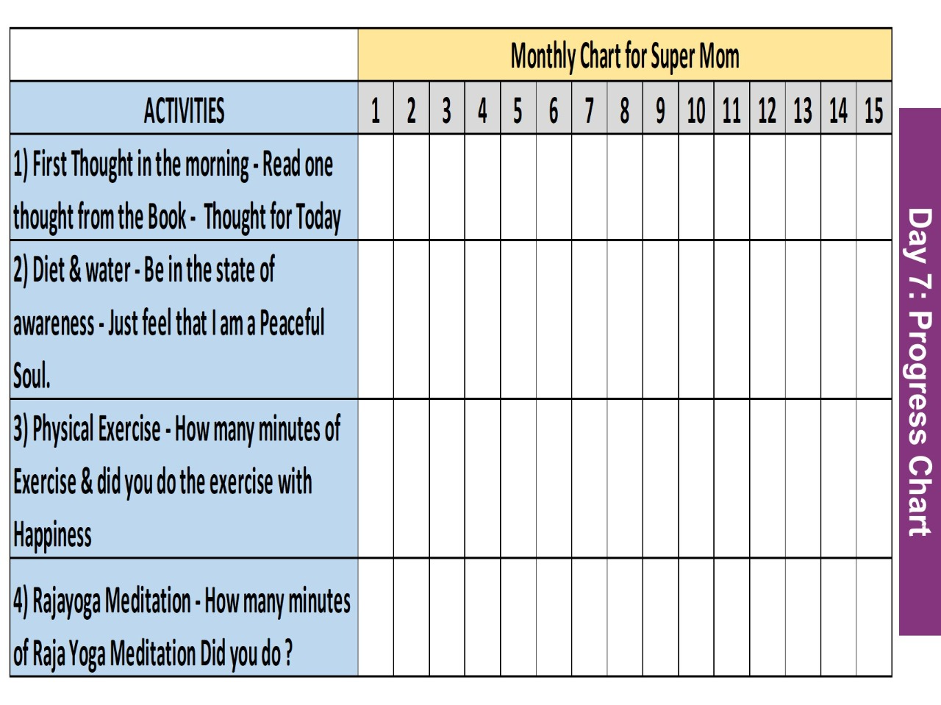

Slide 25
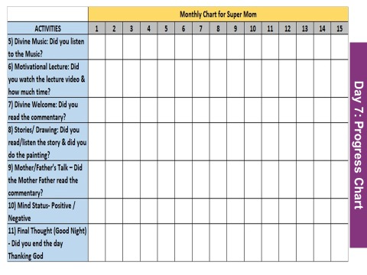

Slide 28
Highlights of the Journal
Hard bound cover
130 pages of Rich Quality
Daily Reflective Activities
28 Meditation Commentaries
Diet Chart
Exercises/Pranayama for Normal Delivery
Weekly Baby Talk Transcript
Hospital/Labour Room Checklist
Comprehensive Guide for Rajyoga Meditation
Practical Tips of Sleep Hygiene
Auto suggestions for sound sleep
Maths Masti - Creative Puzzles with Solutions
Bi lingual (English & Hindi)
7304255292
9833801570

Slide 29
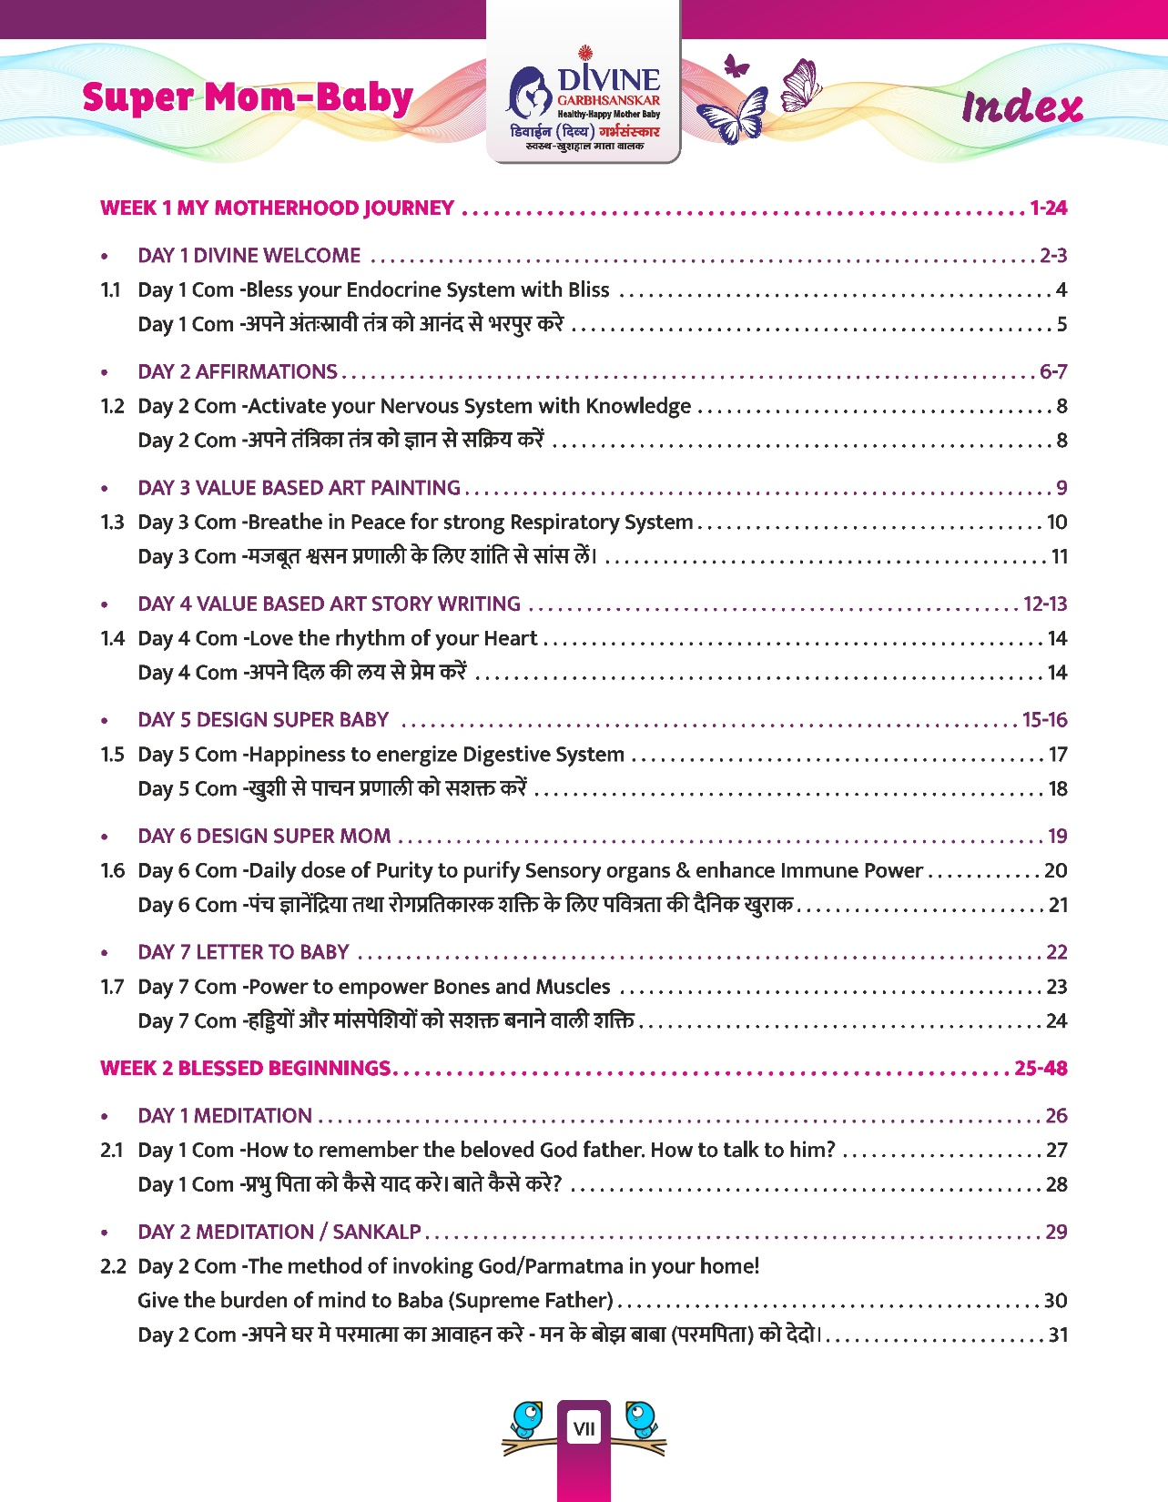

Slide 30
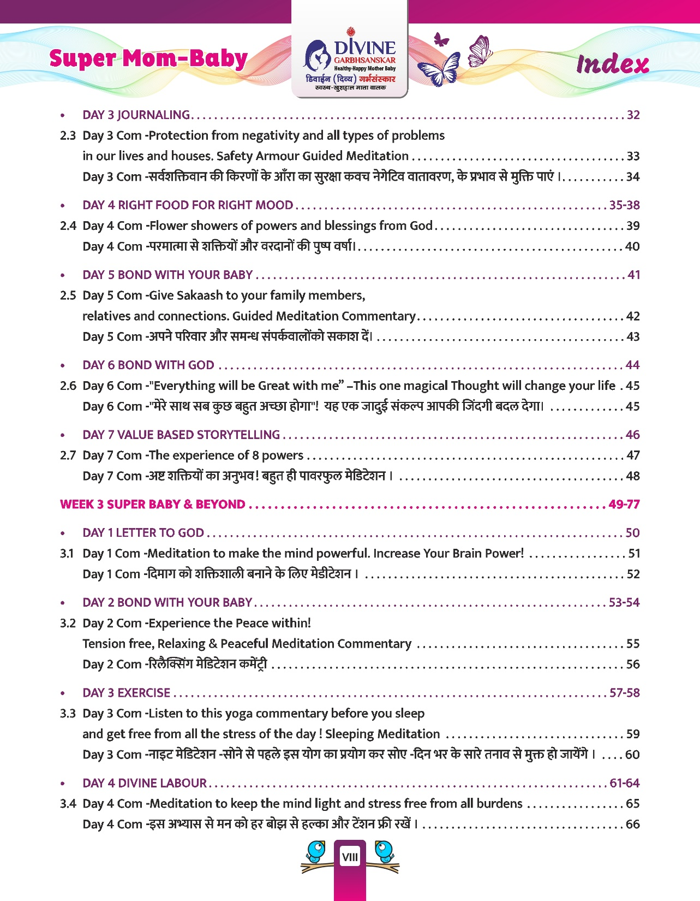

Slide 31
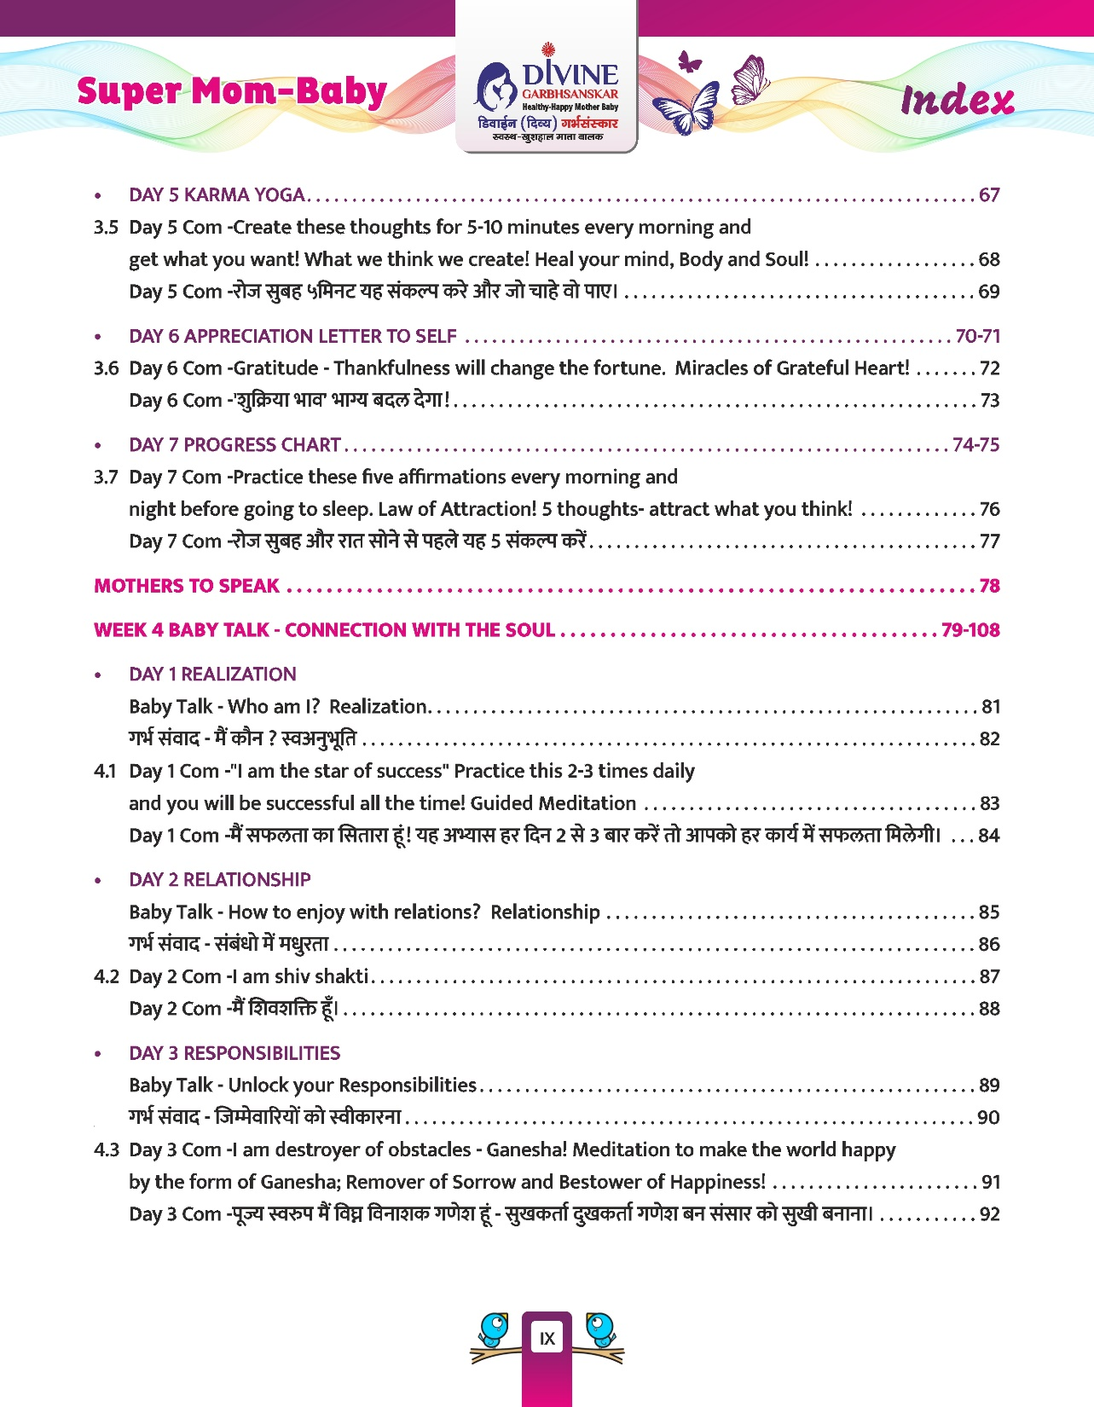

Slide 32
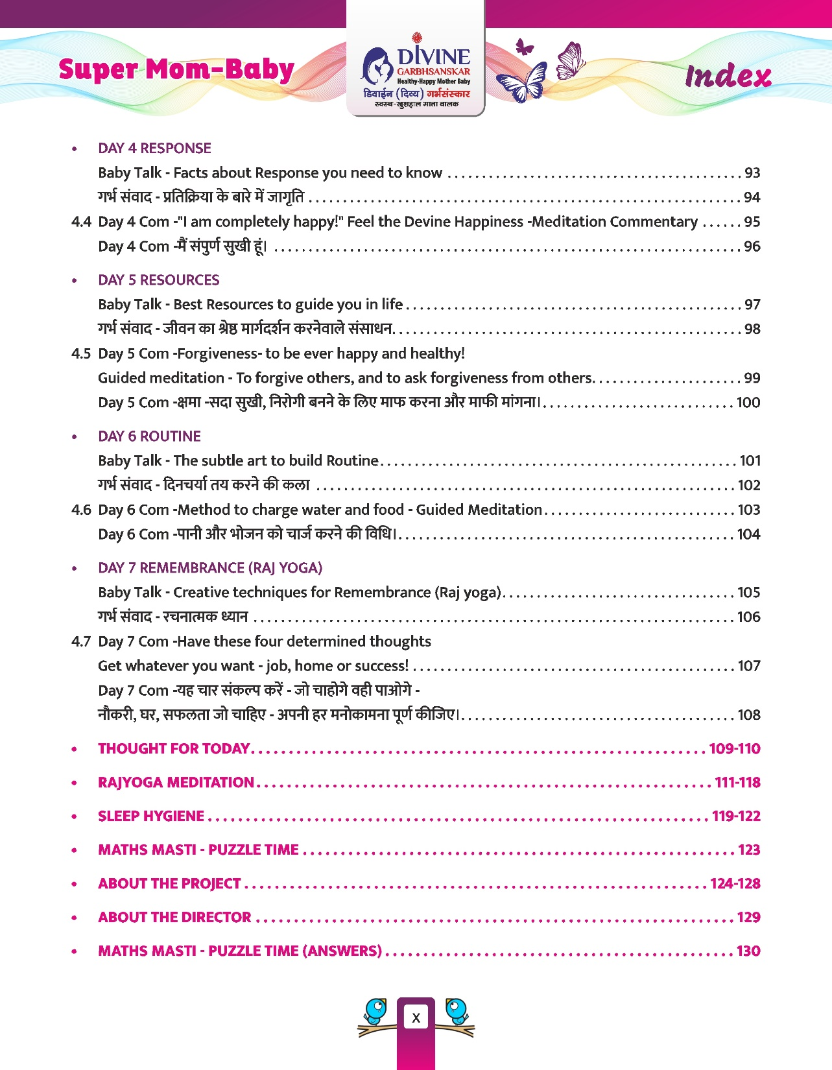

Slide 34
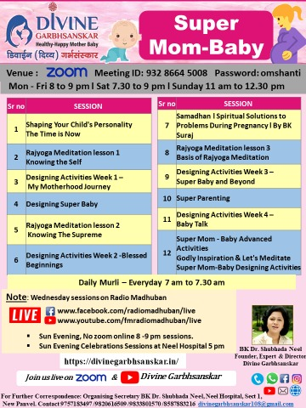

Slide 37
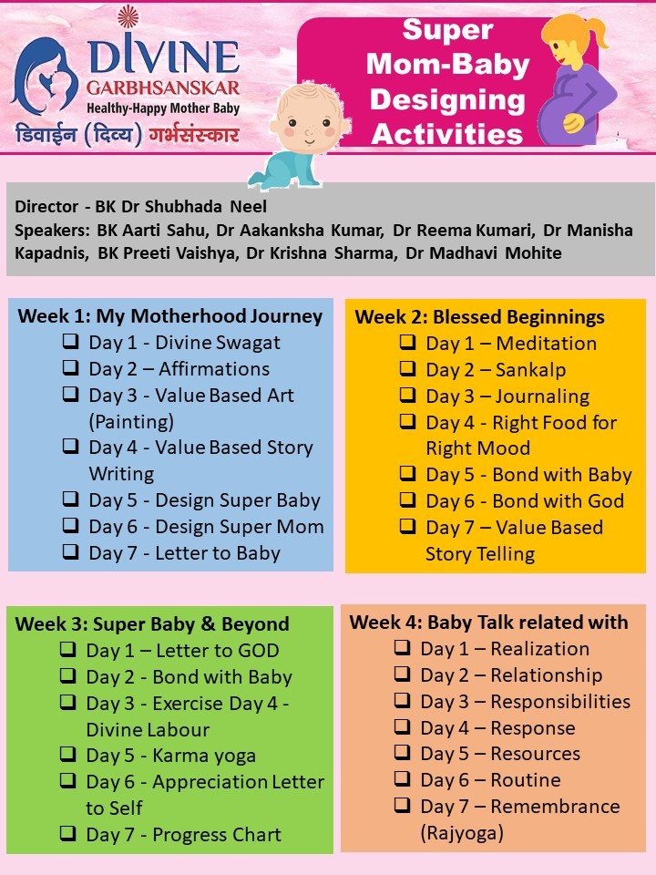

Slide 38
