Slide 1
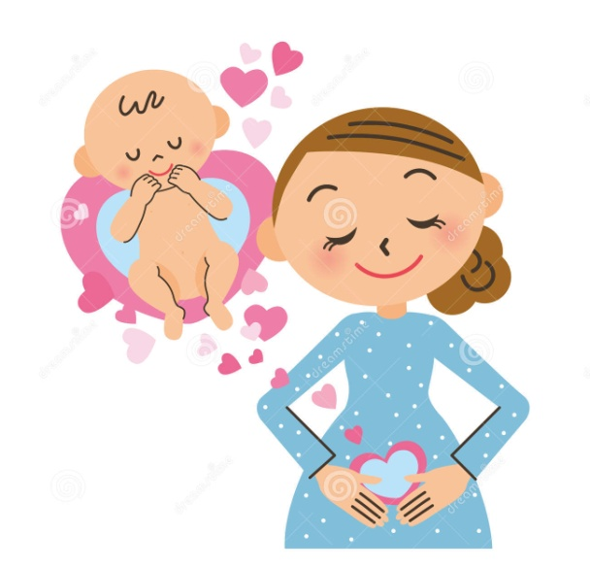
BABY TALK –CONNECTION WITH THE SOUL.
WEEK 4

Slide 2
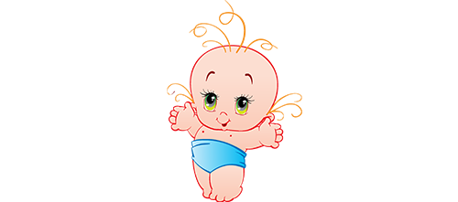
WHY ??? BABY TALK
Not just bonding, talking to your baby bump has a lot of other benefits too.
Among the sounds of a pregnant mother’s beating heart, breathing and blood coursing through veins, the baby is able to hear scuffled noise from the external environment .
Laying the foundations for social and emotional development, as well as their language skills and memory.
It helps in auditory stimulation:
It helps in speech development:
It establishes a sense of security:
It helps in brain stimulation:
It helps to develop parental skills:
It helps to know about baby's wellness in the womb:
It helps to understand individual responsibilities:

Slide 3
HOW???
Learning by Repetition
If a mother repeats certain conversations with the child when In womb, it would be more familiarized with the words and may respond immediately to them.
Learning by Association
The baby may associate certain things and words you say to the way that you feel while you said them. For example, if you are sad and are talking to your baby in the womb, post birth, those words would be associated with sadness as well. The association pattern would be similar for other emotions as well

Slide 4
PREPARATION
SIT IN SILENCE
TAKE DEEP BREATHE
RELAX YOUR BODY
BE COMFORTABLE
PUT YOUR RIGHT HAND ON TH UPPER PORTION OF YOUR TUMMY
LEFT HAND BELOW
CLOSE YOUR EYES
VISUALIZE YOUR BABY IN THE WOMB
START YOUR CONVERSATION NOW WITH A SMILE .

Slide 5
Super Mom-Baby Designing Activities WEEK 4 – CONNECTION WITH THE SOUL
Day 1 – Realize
Day 2 - Relationship
Day 3 - Responsibilities
Day 4 - Response
Day 5 - Resources
Day 6 - Routine
Day 7 - Remembrance (Raj yoga)

Slide 6
WEEK 4 - Day 1 Realize

Slide 7
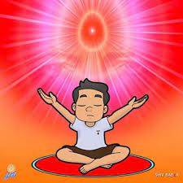
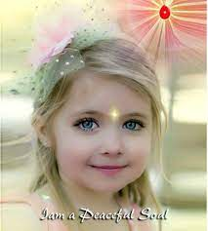
Who am i ?
I am a peaceful soul

Slide 8
Realize who am I?

Slide 9
WEEK 4 - Day 2
Relationship

Slide 10
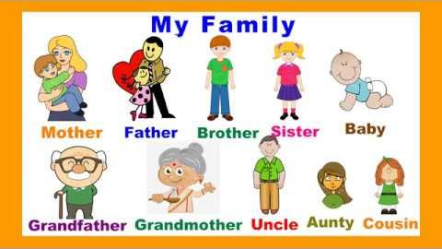

Slide 11
WEEK 4 - Day 3
Responsibilities

Slide 13
WEEK 4 - Day 4
Response

Slide 15
WEEK 4 - Day 5
Resources

Slide 16
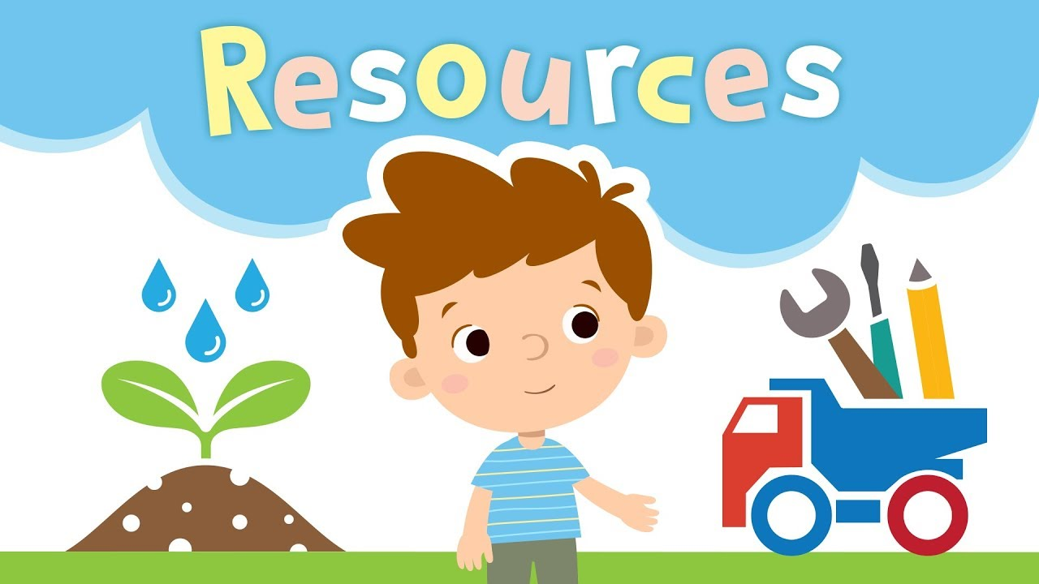
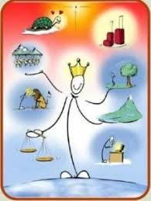
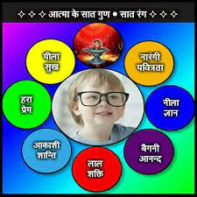

Slide 17
WEEK 4 - Day 6
Routine

Slide 18
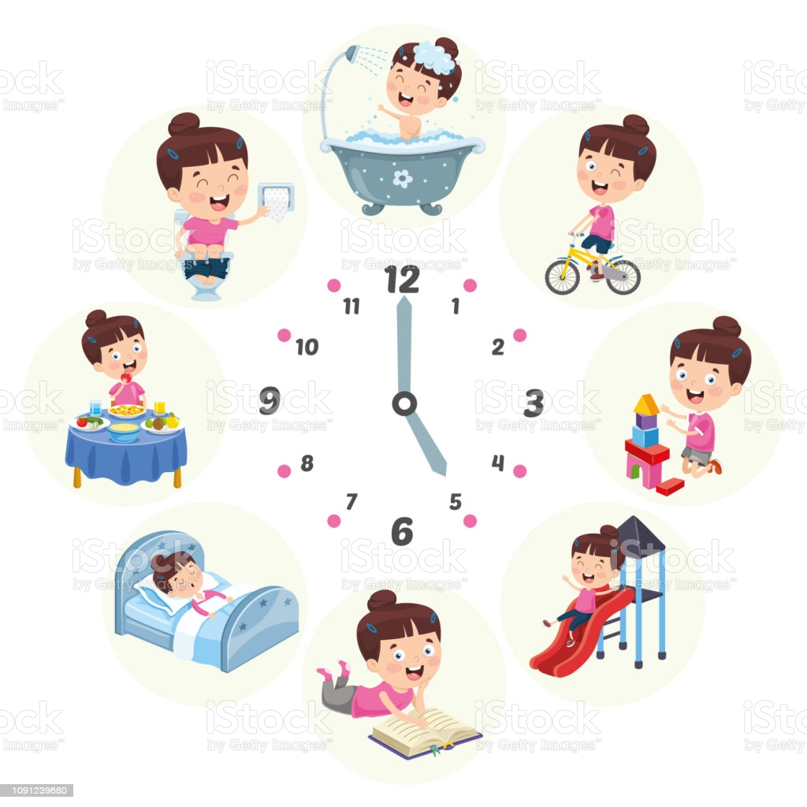

Slide 19
WEEK 4 - Day 7
Remembrance (Raj yoga)

Slide 20
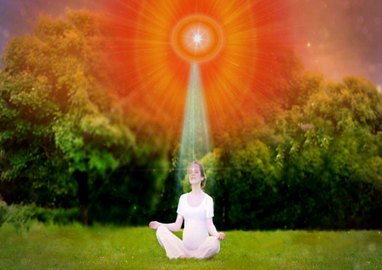

Slide 21
